Slide 1


Slide 2
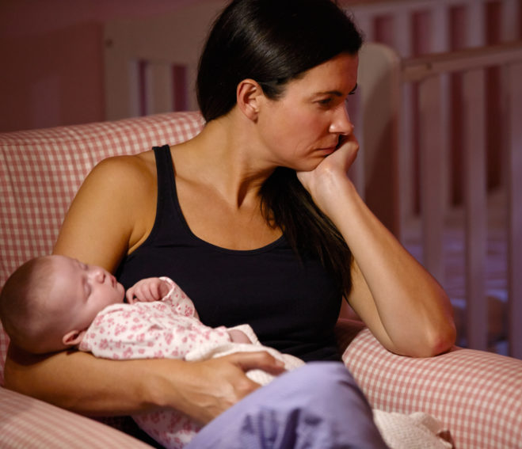
I am a NEW mom
I feel
Anxious
Overwhelmed
Lonely
I am trying to be a good mom.
COVID-19
This is not what I expected
Who do I call?
When am I supposed to call?
Then what…I can’t get out of the house.
I am so worried
what if my baby gets sick? Or I get sick?
Not sure what to do.
Can I do this?

Slide 3
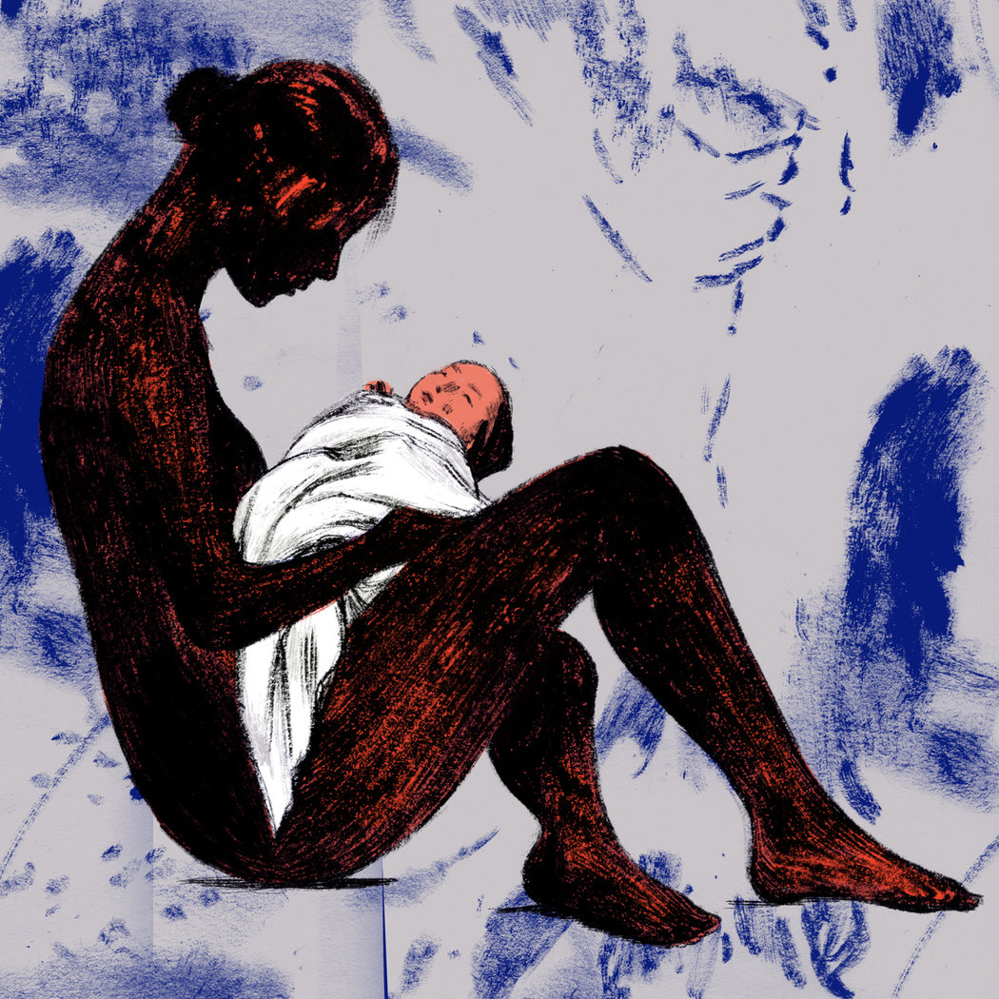
Perinatal Mental Health
Specific to childbearing years (preconception-pregnancy-post delivery;
0-12 months or more)
COVID-19
Anxiety
Isolation
Removes normal social supports for women
1 in 8 women experience post partum depression
Immeasurable human impact
Driving force of maternal and infant health outcomes
$14.2 billion untreated perinatal mental health disorders cost in US in 2017
Barriers
feel insurmountable
Recognize & Be Proactive Now!!

Slide 4





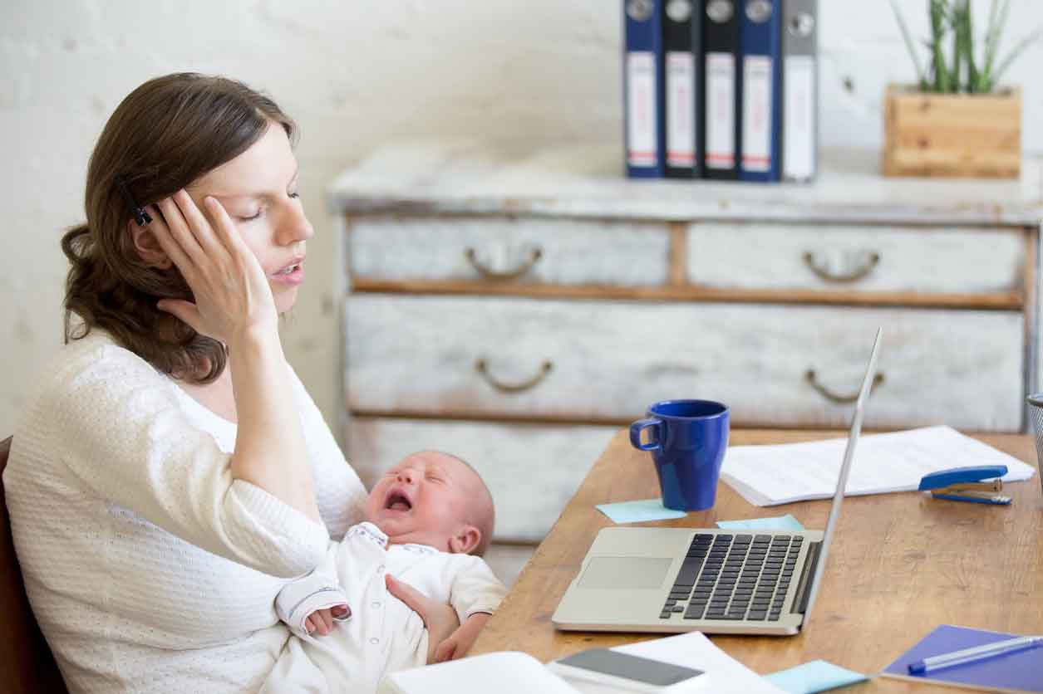


Current Solutions The mother seeks help!
Notes:
Just say there are numerous solutions which are available to women but not appealing or too impersonal. The mother seeks information and help, which may not be reliable or trusted source. She may be overwhelmed. It may be too little too late.

Slide 5


Our Solution
WE INTIATE contact with mothers in their own home
Early timing
Text All moms.
Within 2 weeks
Validated Screening Tool.
Notes:
Spend most time on this slide! What is special about our solution? Most solutions rely on the mother seeking information or help. Our solution invites mothers to be part of this initiative which provides support and information to them. Our solution will be more personal than the other solutions.

Slide 6




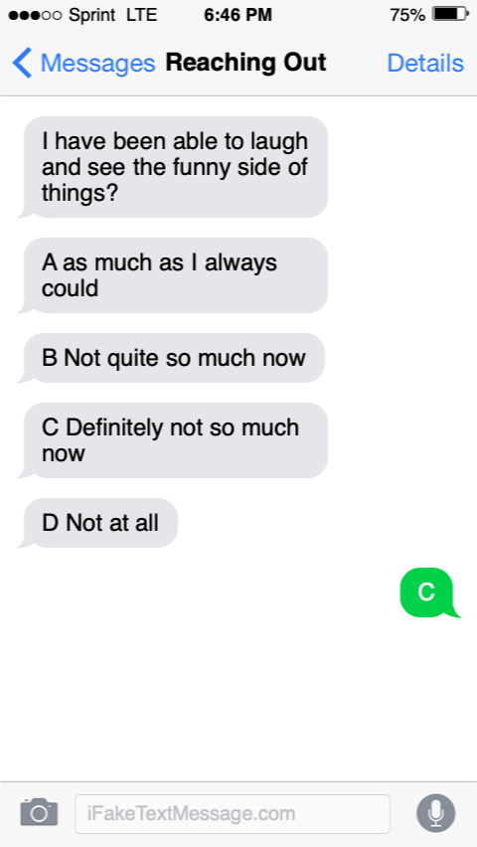

We Text Moms
ROMI E-Nurse
CHAT BOT
Reaching Out
2 Moms
Website & Phone App!
Personal Connection
Directly
With Our Wellness
Team
Creates Intelligent Chat with Moms
Q&A for
Support of Perinatal Mental
Health
www.reachingout.com

Slide 7

Scaling Up & Marketability
Multiple languages
Private clinics
Health care systems
Cultural sensitivity
Partner with telehealth perinatal mental health providers
Increase scope of resources offered
Potential for professional education
Notes:
I wouldn’t spend much time on this. Just that it can be scaled up and is marketable

Slide 8




Amidst COVID-19, new moms are struggling. That’s why we are

Slide 9
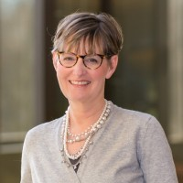

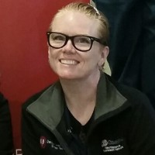
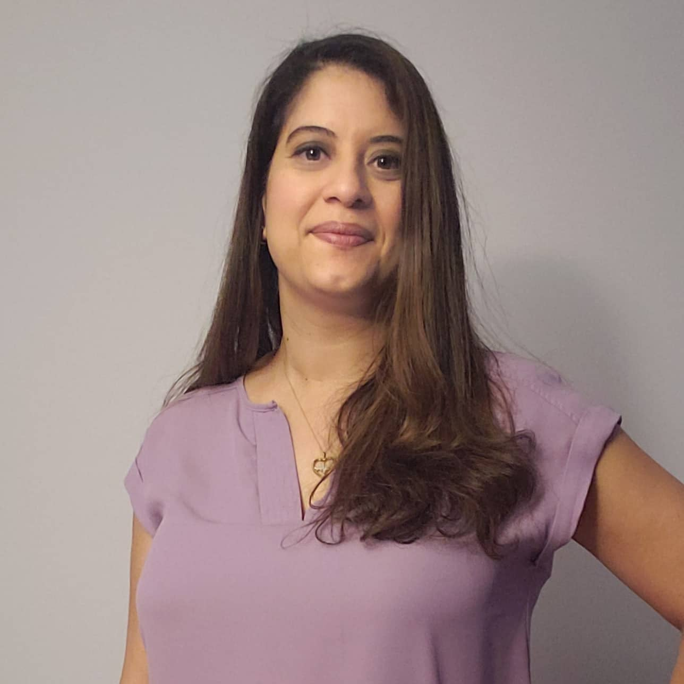
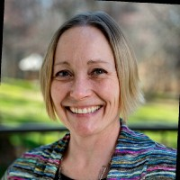
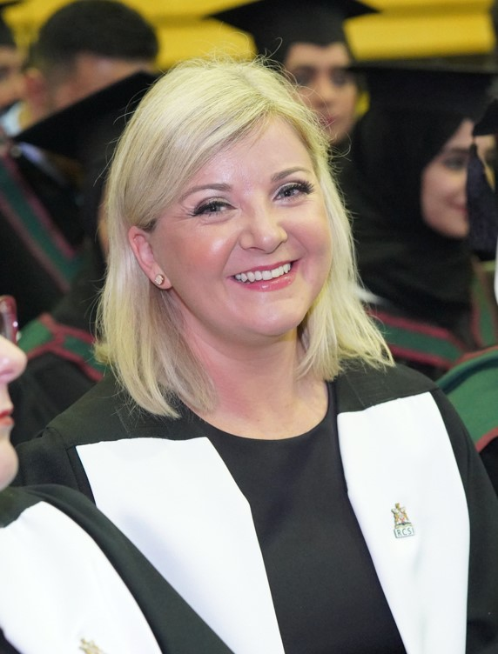
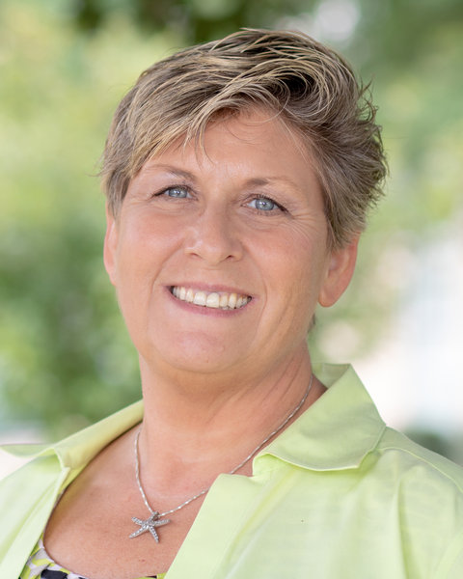
Our Strength We are an All Nurse Team!!: Over 150 Years Nurse Experience Years.
Jennifer Wallace
MSN RN
Robin Blisard
MSN RN-BC
Denise T Levesque
BSN,PHN,MNN, EFM,SCRN
Damaris Grossmann
DNP,FNP-C, HNB-BC, CYN
Deidra Heuring
DNP, RN, CCRN, AHN-BC,
Johnson & Johnson Nurse Innovation Fellow
Kerry S. Risco
PHD, CRNP,NP-C, WCC,CNE
Maeve Anne O'Connell
PhD, RM RGN

